Slide 1
NBA All-Star Voting Model
Patrick Lee • 01.25.2019

Slide 2
All-Star Game
Overview
Annual Game for ‘Stars’
2 teams (East vs West)
Fans Vote
Want to see all the top players playing together in one game
Voting Structure Changes
Loss of appeal and the resurgence!

Slide 3
Mission:
Predicting All-Star votes using the player’s season stats!

Slide 4
How are we going to do it?
Training Set:
1996 - 2016 (20 years)
Only top 50 players per year

Slide 5
How are we going to do it?
Training Set:
1996 - 2016 (20 years)
Only top 50 players per year
Validation Set:
2017 data
440 rows

Slide 6
How are we going to do it?
Test Set:
2018 data
505 rows
Training Set:
1996 - 2016 (20 years)
Only top 50 players per year
Validation Set:
2017 data
440 rows

Slide 7
Scrape Order
Find all available vote count data from 1996 -2018
09.17.XX
SCRAPE

Slide 8
Scrape Order
Merge votes with respective season’s per game stats
Find all available vote count data from 1996 -2018
09.17.XX
10.20.XX
SCRAPE
MERGE

Slide 9
Feature Engineering
Games Started % = GS / GP
Can tell us how often the player is chosen to start the game for the team
Weighted FG% = FG% x FG made
Buffers the high FG% of players who don’t take many shots
Others:
Prior season PointsPerGame
Previous All-Star appearances
One hot encoding Player Positions

Slide 10

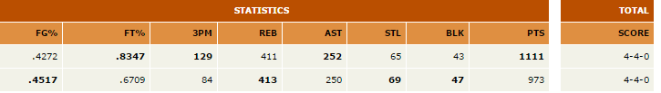
Domain Knowledge
Fantasy Basketball
Extremely popular
Based on statistical categories
Similar Fanbase as voters

Slide 11
Domain Knowledge
Fantasy Basketball
Extremely popular
Based on statistical categories
Similar Fanbase as voters

Slide 12
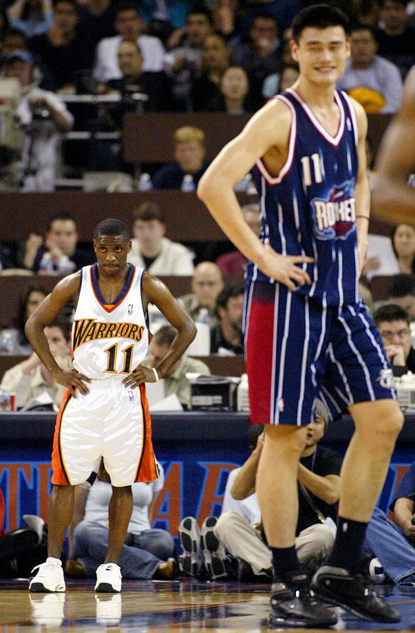
Domain Knowledge
Standardize
Relative stat by Position AND by Year
Divide average stat by max average stat for that position during that season

Slide 13
Results

Slide 14
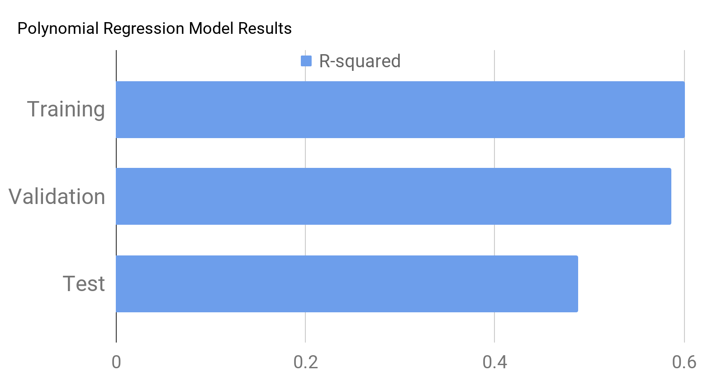
Train R-squared: 0.600 (1996-2016)
Val R-squared: 0.586 (2017)
Test R-squared: 0.488 (2018)

Slide 15
Top Features
Head
Features | Coefficients
Year | 332,277.0
FG x Stars | 164,623.2
Stars | 161,091.9
FG% x TOV% | 132,473.6
FTA x PTS% | 116,385.1
Tail End
Features | Coefficients
Year^2 | -504,393.2
Age x Stars | -416,034.4
Age x TOV% | -156,132.4
Age x PriorPoints | -89,900.5
Rebounds% x SF | -71,910.9

Slide 16
Top Features
Head
Features | Coefficients
Year | 332,277.0
FG x Stars | 164,623.2
Stars | 161,091.9
FG% x TOV% | 132,473.6
FTA x PTS% | 116,385.1
Tail End
Features | Coefficients
Year^2 | -504,393.2
Age x Stars | -416,034.4
Age x TOV% | -156,132.4
Age x PriorPoints | -89,900.5
Rebounds% x SF | -71,910.9

Slide 17
Top Features
Head
Features | Coefficients
Year | 332,277.0
FG x Stars | 164,623.2
Stars | 161,091.9
FG% x TOV% | 132,473.6
FTA x PTS% | 116,385.1
Tail End
Features | Coefficients
Year^2 | -504,393.2
Age x Stars | -416,034.4
Age x TOV% | -156,132.4
Age x PriorPoints | -89,900.5
Rebounds% x SF | -71,910.9

Slide 18
Top Features
Head
Features | Coefficients
Year | 332,277.0
FG x Stars | 164,623.2
Stars | 161,091.9
FG% x TOV% | 132,473.6
FTA x PTS% | 116,385.1
Tail End
Features | Coefficients
Year^2 | -504,393.2
Age x Stars | -416,034.4
Age x TOV% | -156,132.4
Age x PriorPoints | -89,900.5
Rebounds% x SF | -71,910.9

Slide 19
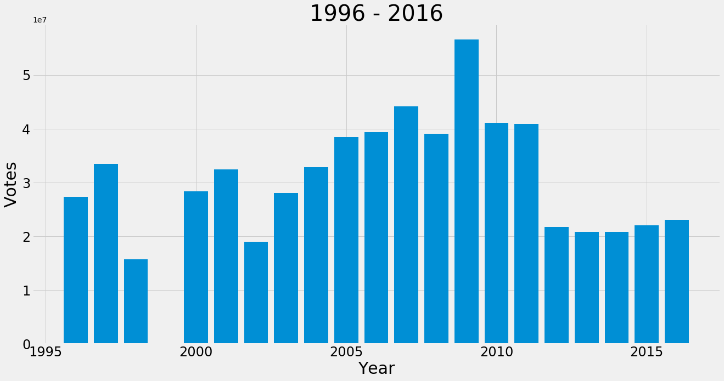
TOTAL VOTE COUNT

Slide 20
TOTAL VOTE COUNT

Slide 21
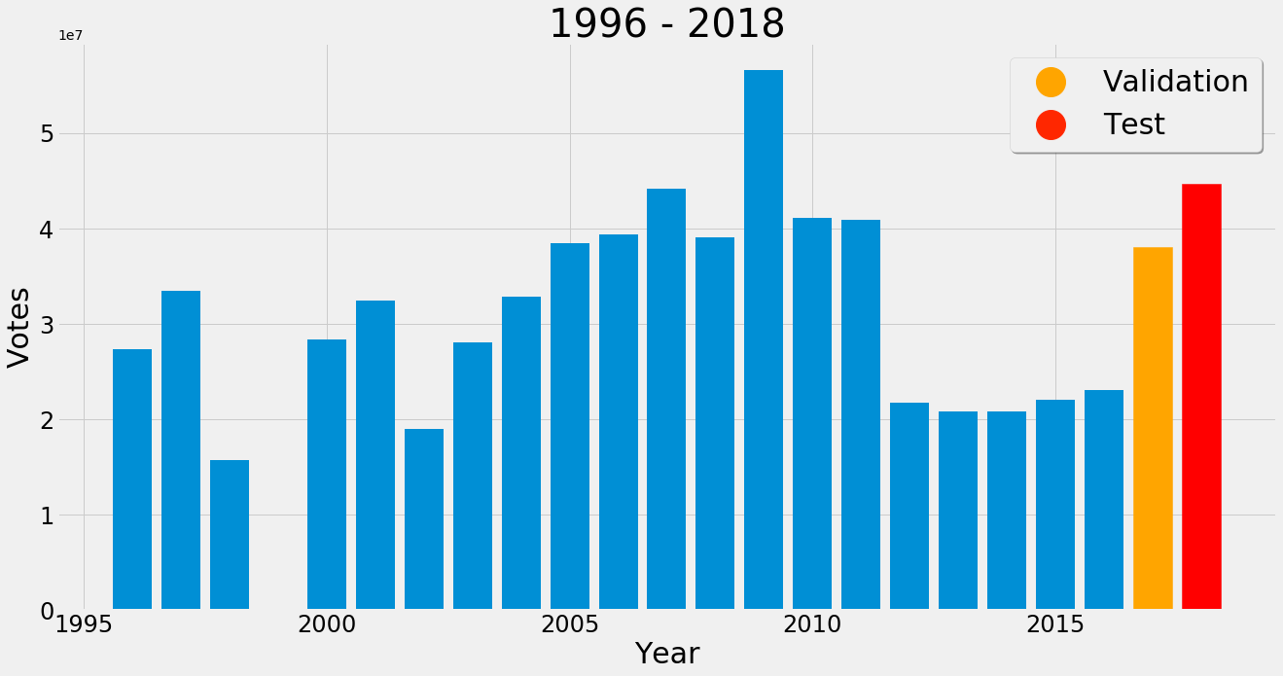
TOTAL VOTE COUNT

Slide 22
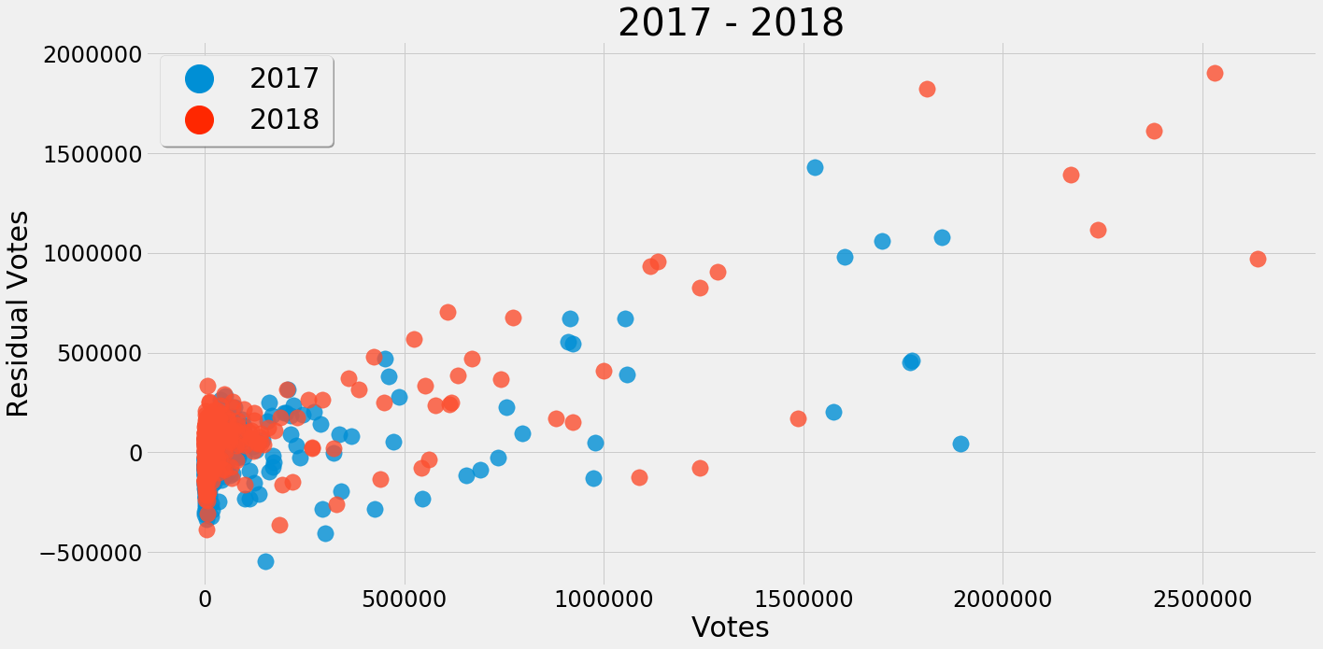
Residuals

Slide 23
Residuals

Slide 24
Residuals

Slide 25
Summary
-Meaningful Features/Coefficients
-Difficult to predict recent years due to NBA All-Star changes

Slide 26
Thank you!

Slide 27
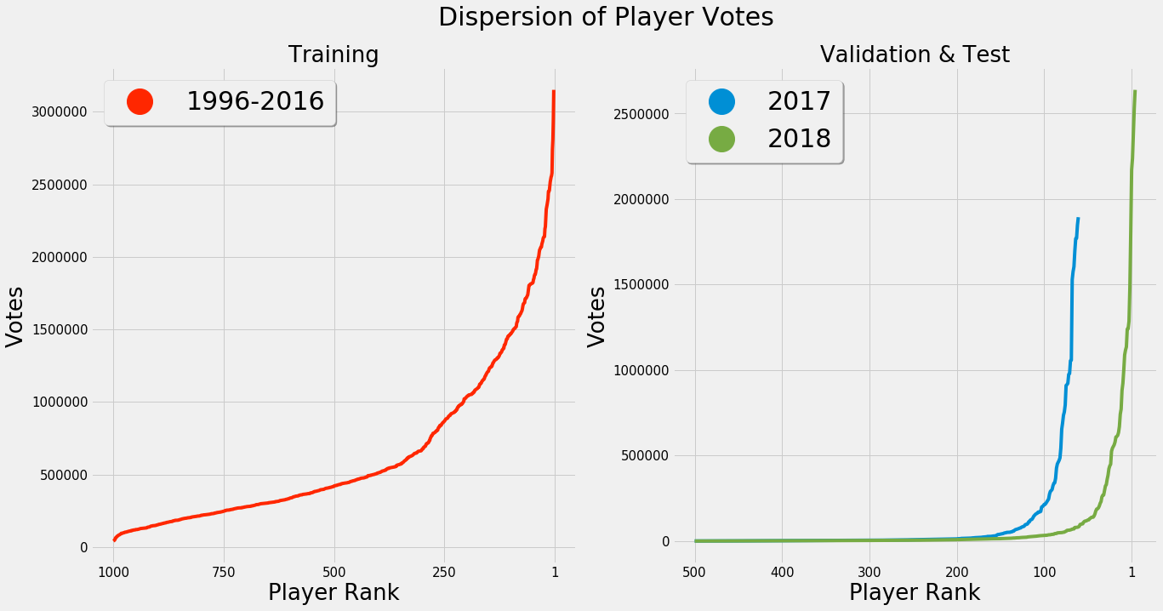
APPENDIX

Slide 28
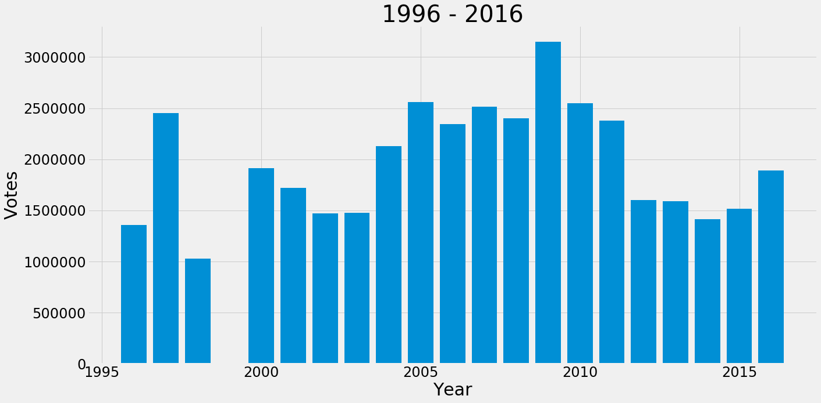
Highest Vote Count on a single player

Slide 29
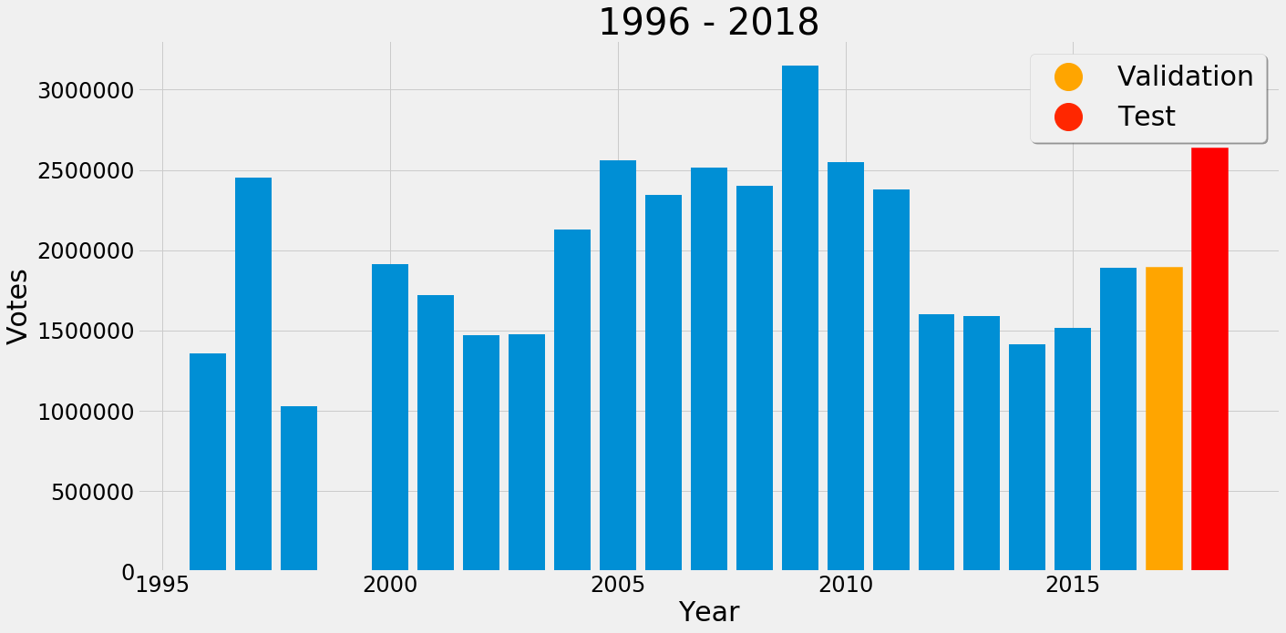
Highest Vote Count on a single player

